Slide 1
IMPES example of 1D displacement
L= 1000 ft
A= 10000 ft²
K = 100 mD
= 0.2
P _{initial} = 1000 psi
S_{wi} = S_{wr} = 0.2
N=3
∆x = 333.33 ft
Q_{in} = 426.5 SCF/day @ x=0
Q_{out} = 426.5 SCF/day @ x=L
c_{w} = c_{o} =1E-5 psi⁻¹
V_{i} = A∆x = 3.33E+6 ft³
∆t = 1 day
B_{w} = B_{o} = 1
μ_{w} = μ_{o} =1
426.5 SCF/day
426.5 SCF/day
P =1000 psi and S_{w} =0.2 at t = 0

Slide 2
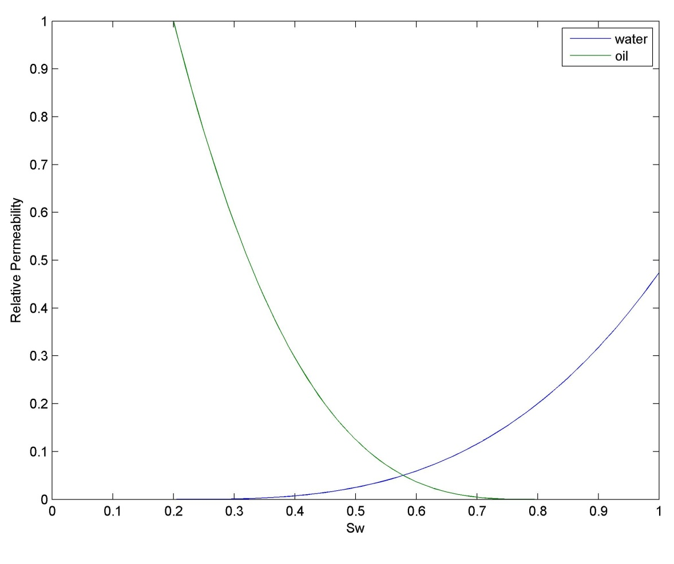
Relative Permeability Curves
k_{rw}= 0.2*S³ and k_{ro}= (1-S)³
S= (S_{w}-S_{wi})/(1-S_{wi}-S_{wr})
k_{rw}=rel perm of wetting phase k_{ro}=rel perm of nonwetting phase S_{w} = saturation S_{wr} = residual saturation S_{wi} = init saturation

Slide 3
IMPES: IMplicit in Pressure, Explicit in Saturation
For each time step:
Solve pressure equation (a system of linear equations) implicitly
2. Using pressure solution for n+1, solve for saturation explicitly for n+1
*** Since the solution is partially explicit it is only conditionally stable
S=Saturation B_{o}=Volumetric Factor [rB/STB] k=perm [mD] q=rate [ft³/day] A=Area [ft²] V=Volume[ft³] T=Transmissibiltiy [(ft³/day.psi)]

Slide 4
Numerical example of 1D displacement
T matrix changes every time step because saturation and therefore relative permeability change
1) Calculate T matrix
At time = 0 S_{w} = S_{wr} =0.2 ➔ k_{rw} =0
Sw = 0.2 everywhere, so Tw and To are the same everywhere
Half transmissibilities are unnecessary since T_{w} and T_{o} are uniform
k=perm [mD] q=rate [ft³/day] A=Area [ft²] T=Transmissibiltiy [(ft³/day.psi)]

Slide 5
Matrix equations (T matrix)
Transmissibilities of each phase
Total Transmissibility is sum of phase transmissibility
T=Transmissibility [(ft³/day.psi)] B=[ft3/psi] P = Pressure [psi] Q= Rate [ft3/day]

Slide 6
D Matrix?
Where the “d” coefficients are given as follows:

Slide 7
Matrix equations (B,P^{l},Q arrays)
Compressibility
Initial pressure
Source Vector
T=Transmissibility [(ft³/day.psi)] B=[ft3/psi] P = Pressure [psi] Q= Rate [ft3/day]

Slide 8
IMPES solution scheme
1) Solve pressure equation implicitly
Pressure increased in block 1 (injector)
and decreased in block 3 (producer)
2) Using pressure solution for t=1, solve for saturation explicitly for t=1
Water only reaches the 1st block
T=Transmissibility [(ft³/day.psi)] B=[ft3/psi] P = Pressure [psi] Q= Rate [ft3/day]

Slide 9
Second time step – Upwinding Necessary!
More complicated because relative permeability is not uniform; evaluate relative permeability in each block based on Sw.
P1 > P2 > P3
Block 1
Block 2
Block 3
T=Transmissibility [(ft³/day.psi)] S=Saturation kr = Rel. Perm P = Pressure [psi]

Slide 10
Calculate interblock transmissibilities
Based on upwinded relative permeabilities
Based on harmonic mean of permeabilities (but we have uniform permeability)
Water Transmissibilities
Oil Transmissibilities
T=Transmissibility [(ft³/day.psi)] S=Saturation kr = Rel. Perm P = Pressure [psi]

Slide 11
Matrix equations for 2nd time step
Transmissibilities came from using upwinding on rel perms
B and Q do not change in this problem (B would if phase compressibility's of oil and water were different)
Current pressure
Next pressure
Current saturation
Next saturation
T=Transmissibility [(ft³/day.psi)] B=[ft3/psi] P = Pressure [psi] Q= Rate [ft3/day]

Slide 12
Matrix equations for 3nd time step
Transmissibilities
Current pressure (psi)
Current saturation
T=Transmissibility [(ft³/day.psi)] B=[ft3/psi] P = Pressure [psi] Q= Rate [ft3/day]

